Slide 1

Is Your Neighborhood Contaminated?
A study of potential contamination via reported hospital diagnosis

Slide 2
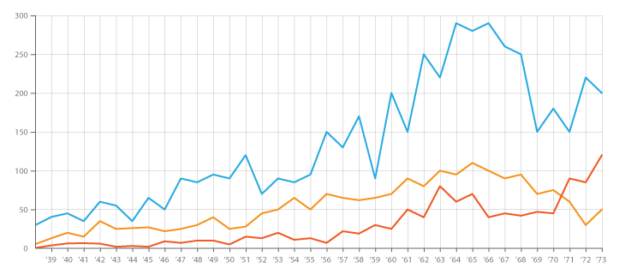
Overview / Description
By 2020 rates of chronic disease are expected to reach 57% according to WHO.
Autoimmune and cancer are also expected to continue
to increase
EPA, Realtors, Insurance Agencies, Individuals
looking to move all need to know how
a location is affecting
health

Slide 3
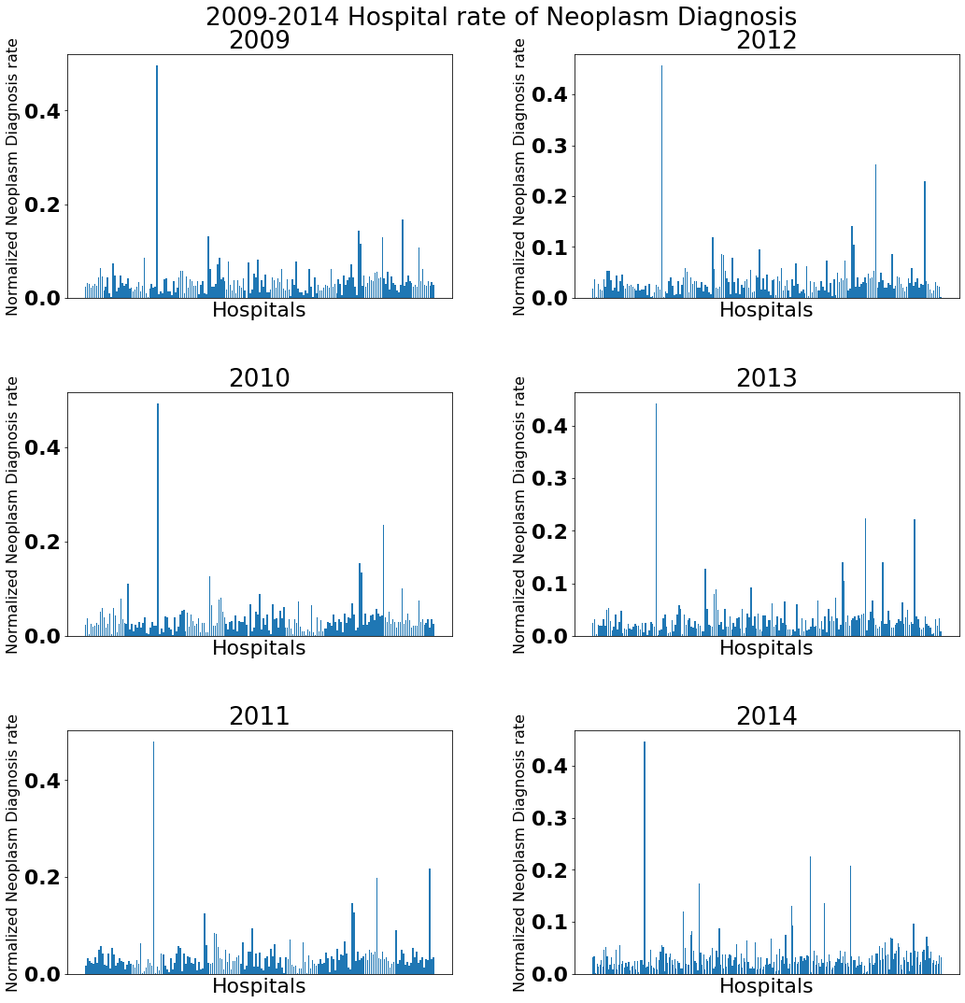
Data Collection and Cleaning
Collect Data on Hospitals / Diagnosis
census.gov, epa.gov, or data.chhs.ca.gov
Data contains
>40,000 rows
18 different diagnosis types
Clean and Combine relevant information
Attach longitude and latitude to hospital diagnosis
Create total diagnosis per hospital
Create diagnosis ratios per hospital
Remove outliers from tests

Slide 4
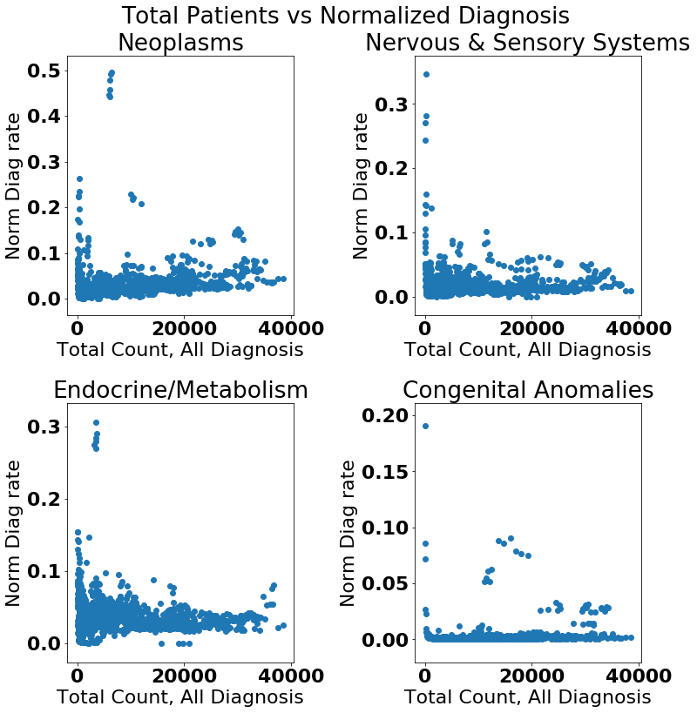

Does more people Equal more illness?
Guess Not

Slide 5
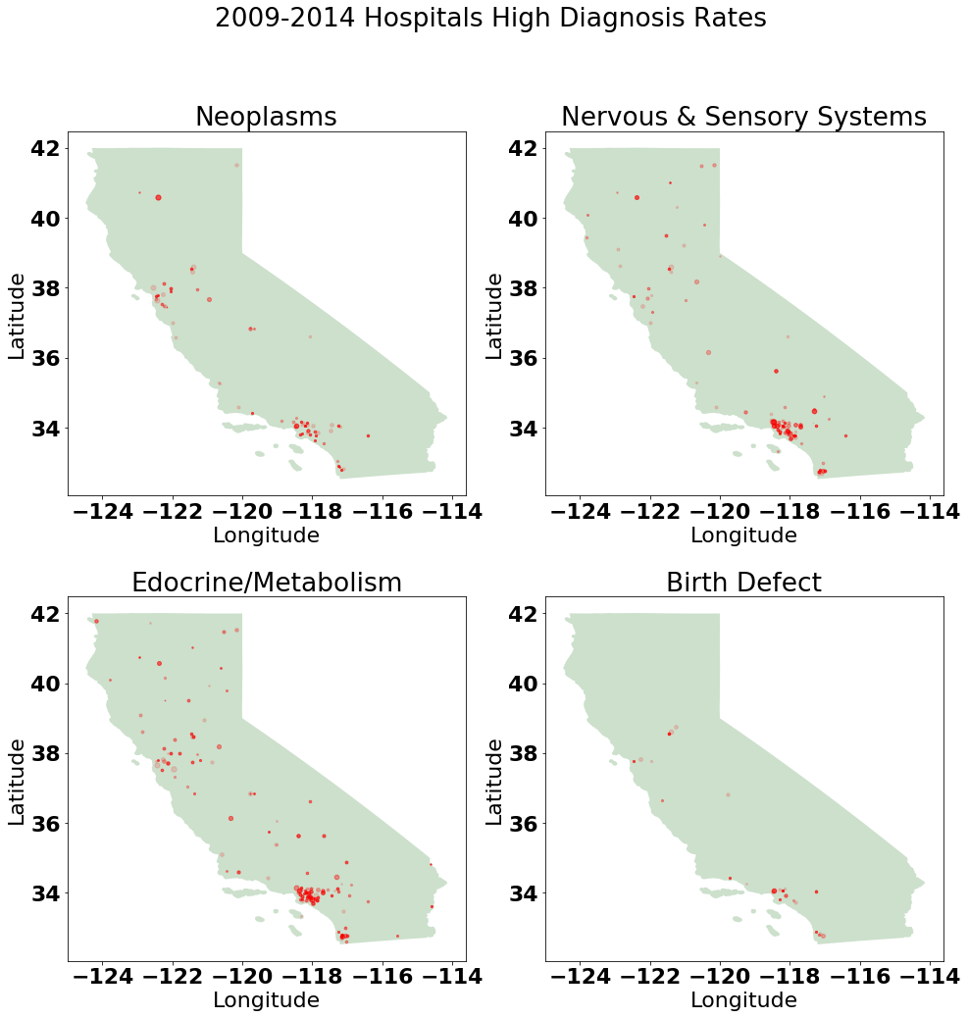
STATS!
Questions:
Is a hospitals rate of diagnosis higher than the rate for the rest of California in a given year
Null Hypothesis:
The rate of diagnosis for a hospital is the same or lower than the rate of diagnosis for the rest of California
Alternate Hypothesis:
The rate of diagnosis for a hospital is higher than the rate of diagnosis for the rest of California
Rejection Threshold:
α = 0.05

Slide 6
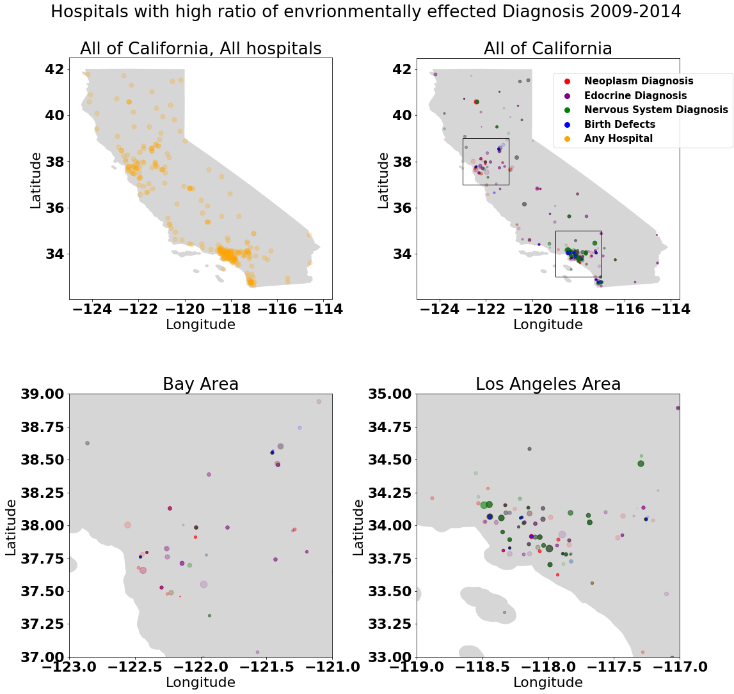
And
GRAPHS!

Slide 7
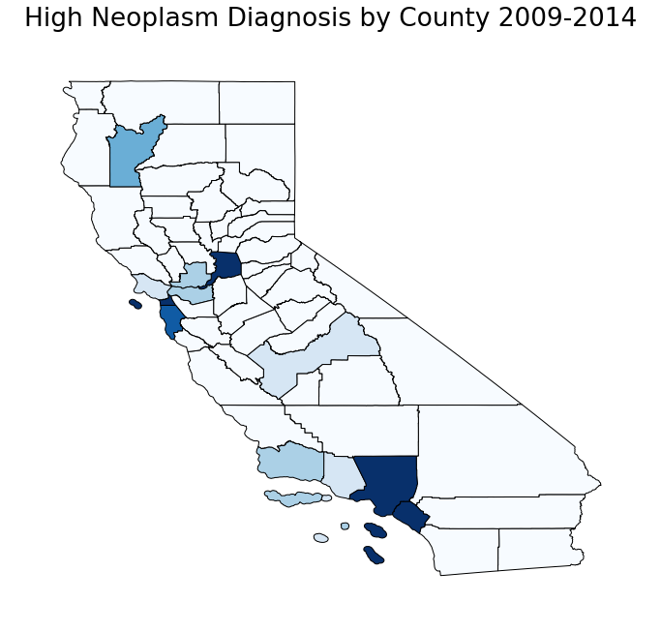
Go
BIGGER!

Slide 8

Conclusions
Major cities have health problems but not all
Los Angeles is pretty unhealthy
Massive data limitation
Going forward
Get more data
AL grouping analysis

